Slide 1



Project 3- NLP To Optimize SEO

Slide 2

Introduction
The offered Python script looks to be a resource for assessing how well a certain site and keyword perform in search engine optimization (Vinutha, M. S., & Padma, M. C. (2023)).
It uses NLP and a Google search to determine the phrase's significance on the requested page and in the top 10 search results.
This program employs web scraping and natural language processing tools and provides a URL and keyword input interface.
It also searches Google for related results, making it a great SEO and content enhancement tool.
The project's HTML code generates the website pages that make up the UI and facilitate efficient user-application interaction.

Slide 3

Value
1
High Value: SEO Analysis
In terms of search engine optimization, the script is a useful tool for website owners and content authors. It enables them compare their webpage's keyword optimization with the highest search results.
2
Medium Value: A Keyword Analysis
NLP keyword extraction and analysis reveal keyword significance. This aids content optimization.
3
Low Value: Integrating Google Search
Users may compare their content to the competition by retrieving and analyzing top Google search results.

Slide 4

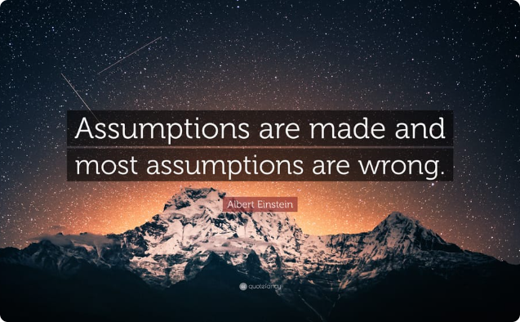
Avoiding Assumptions
Assumptions
Web queries to retrieve site content and Google searches need a steady internet connection, which the script expects. An unreliable internet connection might cause problems (Batiuk, T., Vysotska, V. (2022)).
For analysis, the script requires a valid URL and keyword. Invalid inputs may cause the script to malfunction.
The code presupposes a constant structure for the evaluated websites from which useful material can be readily retrieved. A dynamic or unusual site structure may prevent the script from extracting the necessary data.

Slide 5


Managing Risks
Risks
The code requests material and search results from the web. Rate limitation, particularly while searching Google, may result in partial or erroneous results.
The code requires a keyword match. The SEO score may be affected by inaccurately counting term variations or synonyms (Camargo, J. L., Miranda, M. E. C.(2022)).
The code uses outside tools like NLTK, BeautifulSoup, and requests. Updates to these libraries without proper code maintenance might cause compatibility concerns.
Poor error handling may cause unexpected script failures or unhelpful error messages, making it hard for users to troubleshoot problems.

Slide 6

User stories
1
As a website owner
2
I want to
3
so that
I want a place to enter my blog's URL and a keyword for optimization.
so that I can easily gauge my content's SEO success and enhance it for the search engines.
1
As a content creator
2
I want to
3
so that
I want to execute the script with a URL and keyword, to test my webpage's keyword optimization.
boosting my content's SEO.
1
As a blogger
2
I want to
3
so that
I want to contrast my material to the top 10 keyword search results.
provide feedback on my content approach and areas for development.

Slide 7

Prioritizing error handling
1
High Priority: Error Handling
The code should have full error handling to handle problems like failed web calls, missing data, or failures in an orderly way. This makes the script strong and user-friendly..
2
Medium Priority: Comments and Documentation
Commenting and documenting code improves readability and maintainability. Function descriptions, variable use, and a script summary are needed.
3
Low Priority: Presenting Data
SEO scores and search results are calculated by the script but not shown. Improving results display, maybe in a user-friendly style, would boost tool value...

Slide 8

Writing Effective Acceptance Criteria
1
Given: Python code with user input
2
When: Running the script requires execution.
3
Then: Acceptance requirements are below.
The script starts.
I entered a proper URL and search term.
The script has to.
Completely retrieve the specified web page from the given URL.
The SEO score is based on the frequency with which a certain term appears on a page.
Show the user their SEO rating in the admin panel.
1
Given: Python code with user input
2
When: Running the script requires execution.
3
Then: Acceptance requirements are below.
The script starts.
I entered a proper URL and search term.
The script has to.
Get the first 10 results from Google for the given search term.
Determine each top 10 result's keyword occurrence.
Display top 10 results with page titles and keyword counts..

Slide 9

Estimated time
1
High Value: Resolving faults: 2-3 hours
It should take a few hours to provide adequate exception handling, status code evaluates and meaningful error messages.
2
Medium Value: Comments and documentation: 1-2 hours
A few of hours should be spent documenting the code's functionality and use.
3
Low Value: Presenting data: 3-4 hours
Adding a front-end framework and changing the user interface may improve results display. This may take hours.

Slide 10
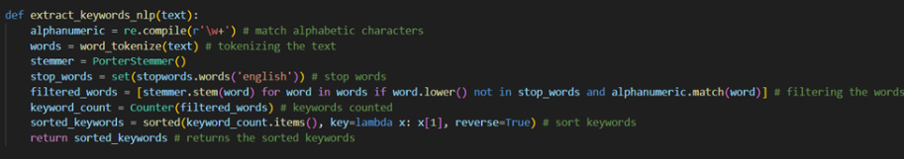
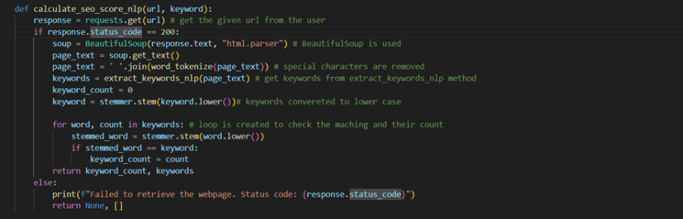
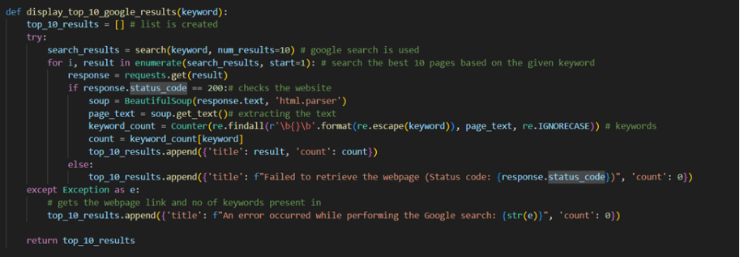
Methods
This method will stem the words, count how many times each keyword appears, and order the keywords based on frequency after tokenizing the input text and removing stopwords and non-alphabetic letters. It's useful for text mining and SEO analysis, two natural language processing applications that benefit greatly from keyword extraction and analysis.
The user inputs a term, and the method obtains a website, parses the text, extracts keywords, and returns the total number of occurrences of that keyword. If the website cannot be retrieved, an error notice is shown and the proper data are returned.
The keyword is entered into Google's search bar, and the top 10 results are returned. From there, the method examines each page to determine how many times the keyword appears. It recovers from process-related mistakes and delivers a list of outcomes for analysis.

Slide 11
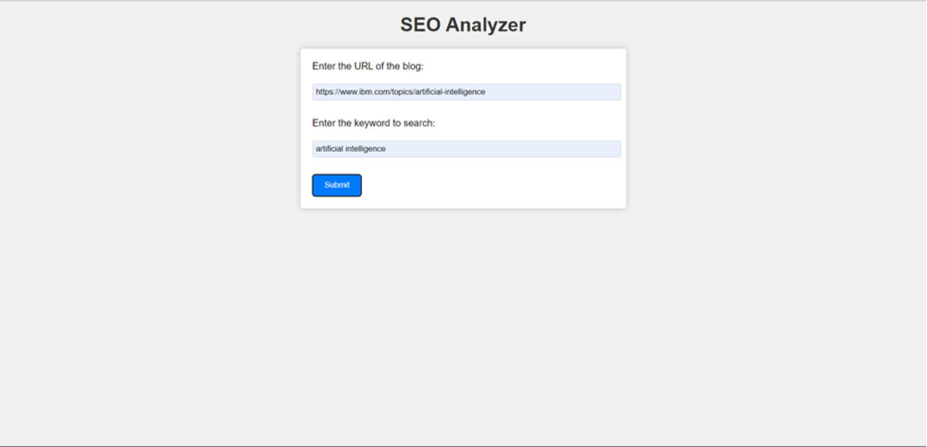
Result
One of the most important parts of SEO analysis is entering the blog's URL and the keyword to see how effectively the material is optimized for the term. It helps improve search engine ranking and exposure by assessing the keyword's presence and relevancy in their content.

Slide 12
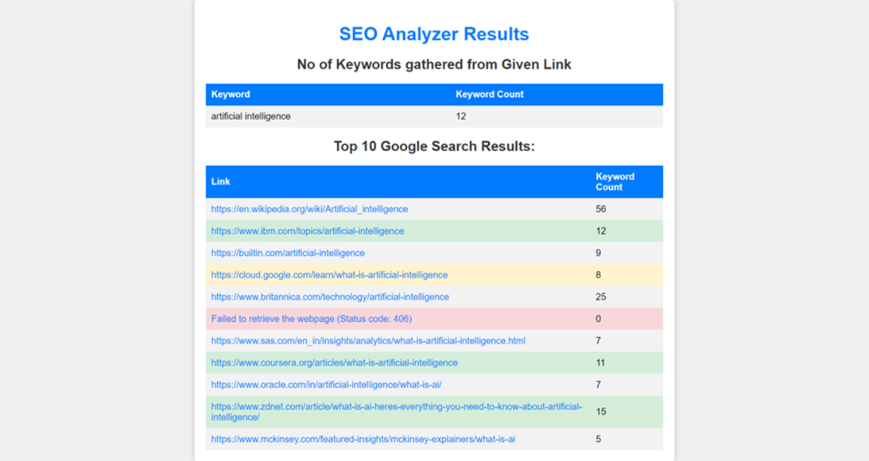
Cont,.
The code analyzes the level of optimization for a given keyword inside the blog's content and compares it to the top 10 results for that term on Google to offer insights on the blog's SEO performance. It's a great resource for anyone who want to learn more about search engine optimization and how it might help them.

Slide 13
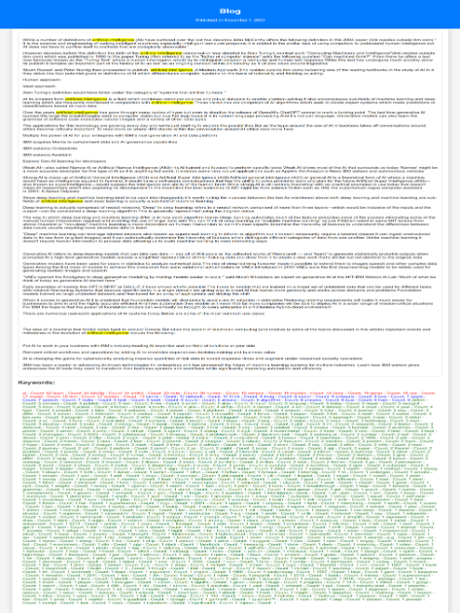
Cont,.
The outcomes of the analysis provide users valuable insight into the effectiveness of a certain blog or website in terms of SEO (Search Engine Optimization). It lets people see how effectively the content of that website is optimized for the selected term. To boost their search engine results, content writers and website owners must use this data to add the right keywords into their work. It provides a metric for gauging how applicable a set of keywords is to a given web page.

Slide 14

Conclusion
The offered Python script is a helpful resource for doing SEO research by measuring the importance of a term on a website in relation to the top 10 results on Google.
The script analyzes content SEO using web scraping, NLP, and online searches.
There is potential for improvement in the script with regards to managing errors, documenting the process, and displaying the outcomes (Umam, A. F. (2023)).
These improvements may make the tool more powerful, user-friendly, and instructive. The script assumes certain things and may be affected by site structure, results from search engines, and other dependencies.
Maintenance, error handling enhancements, and external dependency monitoring are necessary to optimize script efficacy and reduce hazards.
With a clear grasp of its powers and limits, this script may help website owners, content writers, and digital marketers improve their material for SEO.

Slide 15
Thank you

Slide 16
Reference
Vinutha, M. S., & Padma, M. C. (2023). Insights into Search Engine Optimization using Natural Language Processing and Machine Learning. International Journal of Advanced Computer Science and Applications, 14(2).
Batiuk, T., Vysotska, V., Holoshchuk, R., & Holoshchuk, S. (2022). Intelligent System for Socialization of Individual’s with Shared Interests based on NLP, Machine Learning and SEO Technologies. In CEUR Workshop Proceedings. CEUR-WS.
Camargo, J. L., Miranda, M. E. C., Chávez, R. A. P., Quispe, F. K. V., Muñoz, I. J. T., & Flores, L. J. R. (2022, June). Proposal of the methodology oriented to the automatic generation of content in SEO positioning. In 2022 17th Iberian Conference on Information Systems and Technologies (CISTI) (pp. 1-7). IEEE.
Umam, A. F. (2023, April). THE IMPACT OF ARTIFICIAL INTELLIGENCE ON SEARCH ENGINE OPTIMIZATION STRATEGIES. In International Conference on Economic Business and Social Science (Vol. 1, No. 1, pp. 197-208).

Slide 17
Any Question

